Slide 1
element.parentNode - returns the direct parent
element.childNodes - returns a nodeList of all the child nodes including the whitespaces
.nodeType; -check it!
The named elements are:
firstChild and lastChild
nextSibling / nextElementSibling
previousSibling / previousElementSibling
Create Element:
var test = document.createElement(“div") - creates new DIV element (not added to DOM)
document.body.appendChild(test); - inserts the element always at the end of the DOM element
parent.insertBefore(newNode, specificElement)
parent.insertAfter(newNode, specificElement)

Slide 2
Elements can be removed from the DOM
Using element.removeChild(elToRemove)
Pass the element-to-remove to their parent
var trainers = document.getElementsByTagName("ul")[0];
var trainer = trainers.getElementsByTagName("li")[0];
trainers.removeChild(trainer);
//remove a selected element
var selectedElement = selectedElement.parentNode.removeChild(selectedElement);
// Altering the Elements
<div id="f"><p id="the-p">text</p></div>
<div id="s"></div>
…
var second = document.getElementById("s");
var theP = document.getElementById("the-p");
second.appendChild(theP);
…
//the DOM is:
<div id="f"></div>
<div id="s"><p id="the-p">text</p></div>

Slide 3
The inline style (not CSS) of each HTML element can be changed
var div = document.getElementById("content");
div.style.display = "block";
div.style.width = "123px";
appendChild() - appending DOM elements to an element
parentNode.appendChild(node) appends the DOM element node to the DOM element parentNode
If parentNode is appended to the DOM, the node is also appended

Slide 4
Optimizing the Appending of Elements
Appending elements to the DOM is a very slow
Here comes the DocumentFragment element; It is a minimal DOM element, with no parent; It is used to store ready-to-append elements and append them at once to the DOM

Slide 5
Appending Elements (2)
DocumentFragment - Append DocumentFragment to the DOM appends only its child elements
http://jsperf.com/append-doc-fragment/2
dFrag = document.createDocumentFragment();
dFrag.appendChild(div);
…
document.body.appendChild(dFrag);

Slide 6
Faster Creation of Elements
Creating a dynamic list of elements
All of the LI elements have the same classes, styles, attributes
Only the innerHTML is different
DOMElement.cloneNode(true) can be used
Creates a full copy (deep copy) of the element

Slide 7
Homework
Write a script that creates a number of div elements. Each div element must have the following
Random width and height between 20px and 100px
Random background color
Random font color
Random position on the screen (position:absolute)
A strong element with text "div" inside the div
Random border radius
Random border color
Random border width between 1px and 20px

Slide 8
Homework (2)
Write a script that creates 5 div elements and moves them in circular path with interval of 100 milliseconds
Create a text area and two inputs with type="color"
Make the font color of the text area as the value of the first color input
Make the background color of the text area as the value of the second input

Slide 9
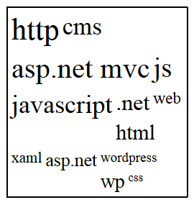
Homework (3)
Create a tag cloud:
Visualize a string of tags (strings) in a given container
By given minFontSize and maxFontSize, generate the tags with different font-size, depending on the number of occurrences
var tags = ["cms", "javascript", "js", "ASP.NET MVC", ".net", ".net", "css", "wordpress", "xaml", "js", "http", "web", "asp.net", "asp.net MVC", "ASP.NET MVC", "wp", "javascript", "js", "cms", "html", "javascript", "http", "http", "CMS"]
var tagCloud = generateTagCloud(tags,17,42);

Slide 10
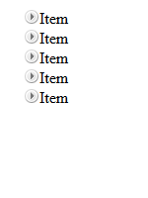
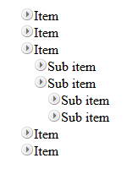
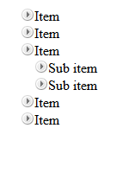
Homework (4)
*Create a TreeView component
Initially only the top items must be visible
On item click
If its children are hidden (collapsed), they must be made visible (expanded)
If its children are visible (expanded), they must be made hidden (collapsed)
Research about events
Initial
Sub item expanded
Top level expanded

